Slide 1

What do you want from me?
Francesco Corti, Product Evangelist @Alfresco

Slide 2

Can you describe…
What a Product Evangelist does in Alfresco?
What a Product (or Developer) Evangelist generally is?

Slide 3
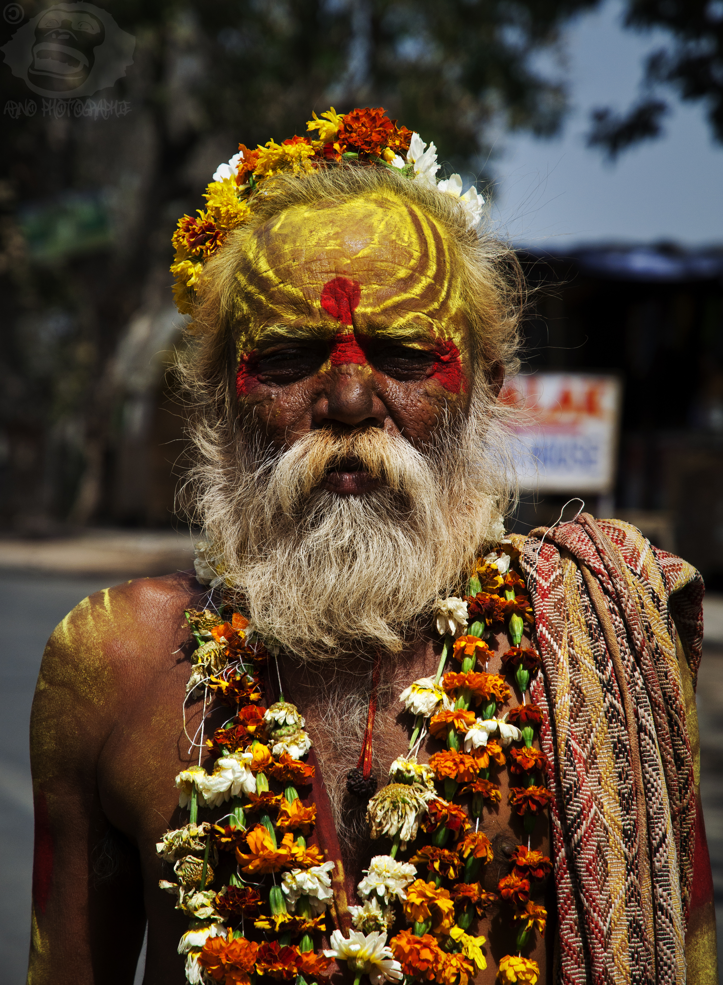
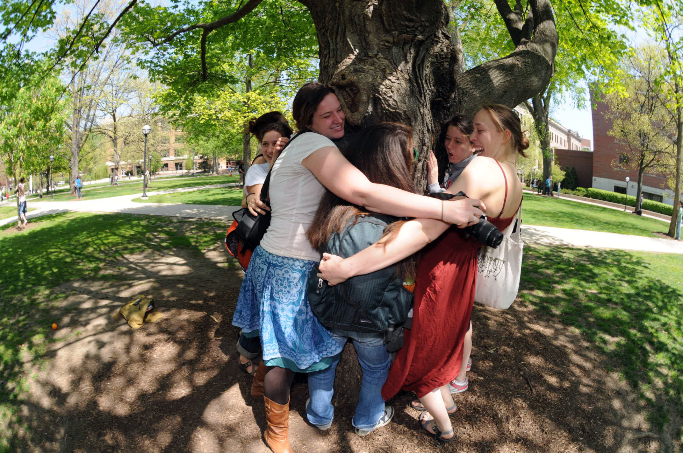
https://www.flickr.com/photos/bononobo/

Slide 4
Definition
A developer evangelist focuses heavily on the developer community, is highly technical and is often a former (or current) developer who also has a core aptitude for communication and articulation. [*]
The role of the evangelist is to build a loyal following through an honest promotion of a product or service. [*]
[*] Michael Sheehan, “What is a Technology Evangelist?”, August 2013

Slide 5
Alfresco’s definition
The Product Evangelist is the key public figure representing Alfresco to the developer community. In addition to helping developers adopt Alfresco technologies, this person will need to help Alfresco improve the developer experience with our technologies.

Slide 6
Main tasks and activities
An evangelist promotes the use of a particular product or technology through talks, articles, blogging, user demonstrations, recorded demonstrations, or the creation of sample projects. [*]
[*] Wikipedia, “Technology evangelist”, last modification on July 2016

Slide 7
The lifecycle

Slide 8
My interest and your opportunity

Slide 9
Let’s play a game
Each slide
is a question
hands up = yes
hands down = no

Slide 10
Results will be published in a blog post
You should continue sharing feedback

Slide 11
Question n.1/10
Are you alive?

Slide 12
Question n.2/10
Are you a Developer or do you work on technical stuff?

Slide 13
Question n.3/10
Do you work with Alfresco for more than 3 years?

Slide 14
Question n.4/10
Did you find easy to get your questions answered?

Slide 15
Question n.5/10
Did you find easy to start developing over Alfresco?

Slide 16
Question n.6/10
Are you happy with the current level of information around
ADF?

Slide 17
Question n.7/10
Are you happy with the current level of information around
REST API?

Slide 18
Question n.8/10
Are you happy with the current level of information around
Search Services?

Slide 19
Question n.9/10
Are you happy with the current level of information around
Activiti?

Slide 20

Question n.10/10
Do you have in mind a suggestion to cover a gap?

Slide 21
If you don’t ask for something,
for sure you won’t have it!
https://www.flickr.com/photos/bononobo/

Slide 22
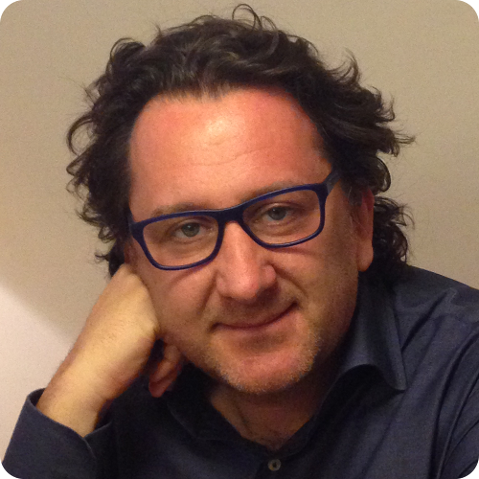
Francesco Corti
Product Evangelist @FrkCorti
francesco.corti@alfresco.com

